Slide 1


Computational Learning Theory
Dr. Hemalatha
AmritaWNA
Amrita Vishwa Vidyapeetham
Notes:
https://www.amrita.edu/news/amrita-surya-vahini-solar-auto-rickshaw

Slide 2
Computational learning theory
Computational learning theory is a mathematical field related to the analysis of machine learning algorithms. It is actually considered as a field of statistics.
Machine learning algorithms take a training set, form hypotheses or models, and make predictions about the future. Because the training set is finite and the future is uncertain, learning theory usually does not yield absolute guarantees of performance of the algorithms. Instead, probabilistic bounds on the performance of machine learning algorithms are quite common.

Slide 3
Computational learning theory
In addition to performance bounds, computational learning theorists study the time complexity and feasibility of learning.

Slide 4
Computational learning theory
Some computational learning questions
What can be learned efﬁciently?
What is inherently hard to learn?
A general model of learning?
Complexity
Computational complexity: time and space.
Sample complexity: amount of training data needed to learn successfully.
Mistake bounds: number of mistakes before learning successfully.

Slide 5
Computational learning theory
There are several different approaches to computational learning theory, which are often mathematically incompatible.
This incompatibility arises from
using different inference principles: principles which tell you how to generalize from limited data.
differing definitions of probability (frequency probability, Bayesian probability).

Slide 6
Computational learning theory
The different approaches include:
VC theory, proposed by Vladimir Vapnik;
Probably approximately correct learning (PAC learning), proposed by Leslie Valiant;
Bayesian inference, arising from work first done by Thomas Bayes.
Algorithmic learning theory, from the work of E. M. Gold.

Slide 7
Vapnik-Chervonenkis (VC) Dimension
In statistical learning theory, or sometimes computational learning theory, the VC dimension (Vapnik–Chervonenkis dimension) is a measure of the capacity of a statistical classification algorithm, defined as the cardinality of the largest set of points that the algorithm can shatter
It gives a pessimistic bound on the number of items a classification hypothesis class can classify without any error.
Assume we have N 2-D points in a dataset. If we label the points in this dataset arbitrarily as + and -, we can label them in 2^{N} ways. Therefore, 2^{N} different learning problems can be defined with N data points.
If for each of these 2^{N} labelings of the dataset, we can find a hypothesis h ∈H that separates the + examples from the examples, we say that H shatters N points.
The maximum number of points that can be shattered by H is called the Vapnik-Chervonenkis dimension of H.
VC(H) is measures the capacity of H.

Slide 8
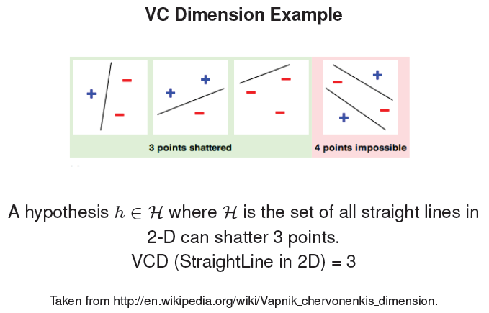
VC Dimension Example

Slide 9
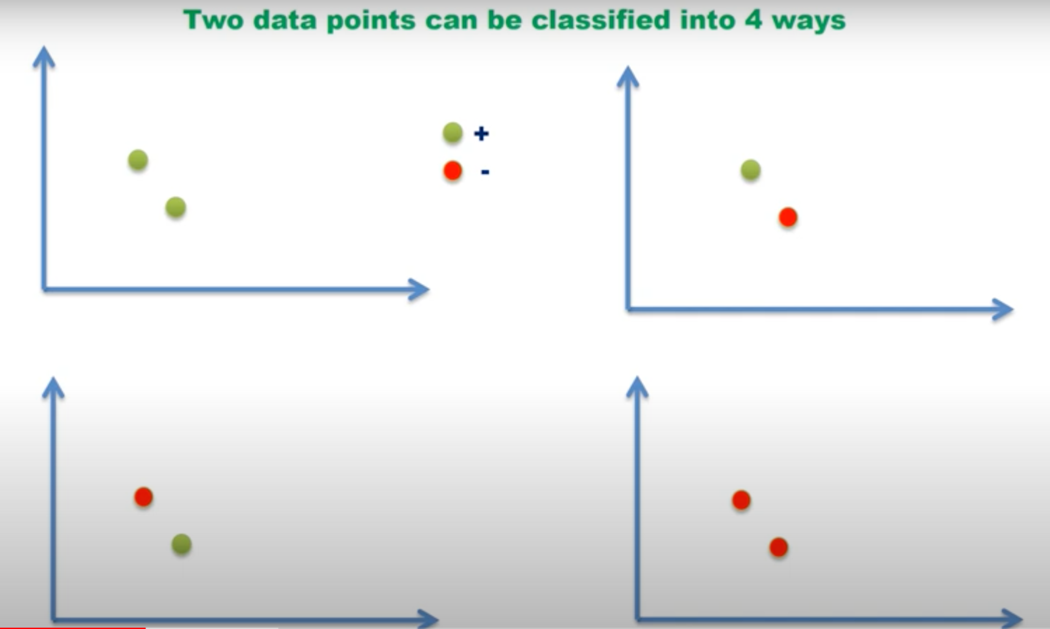

Slide 10
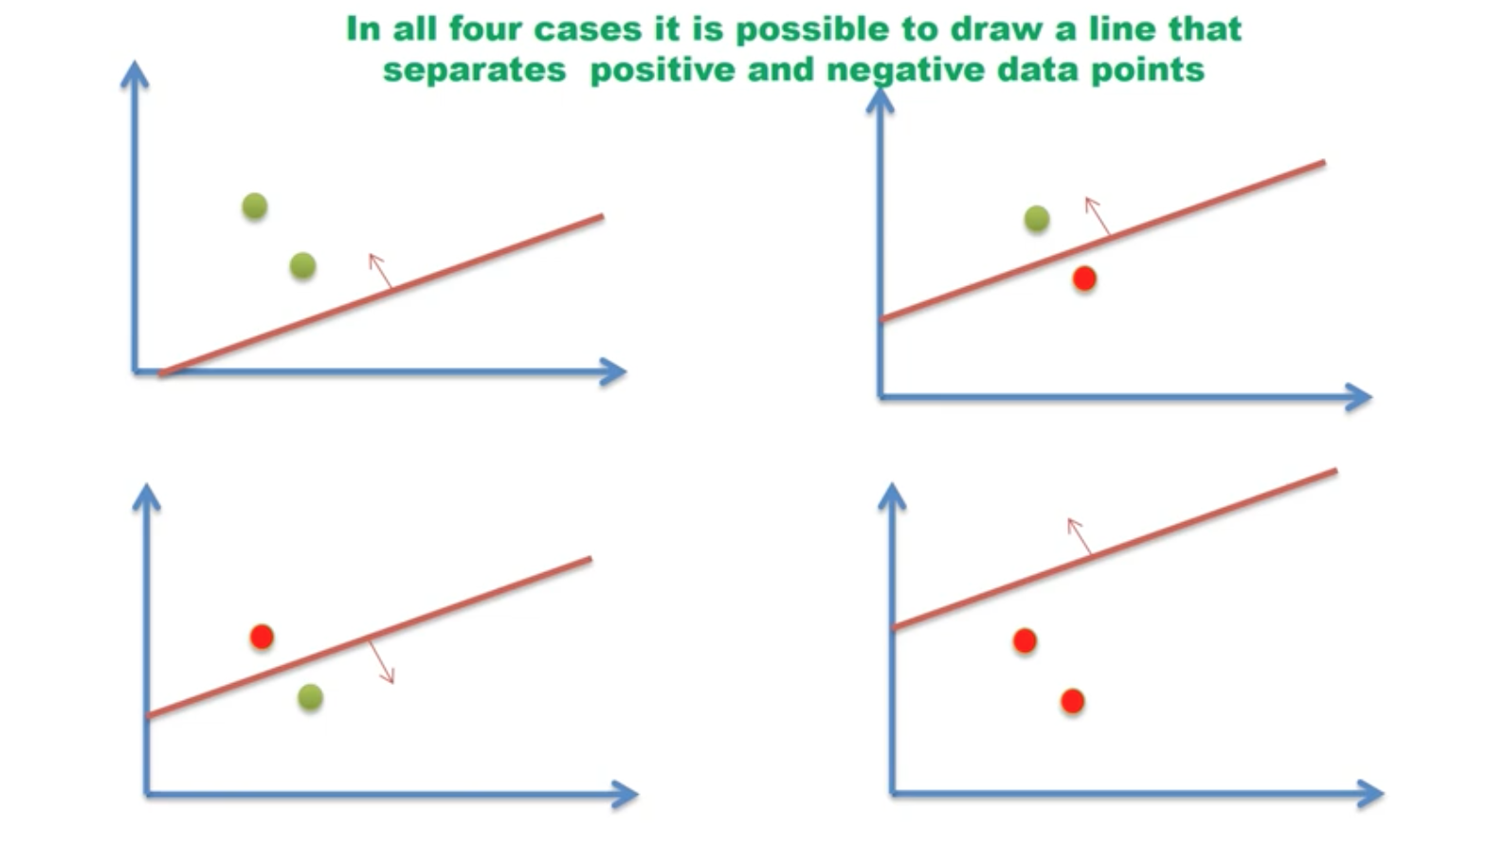

Slide 11
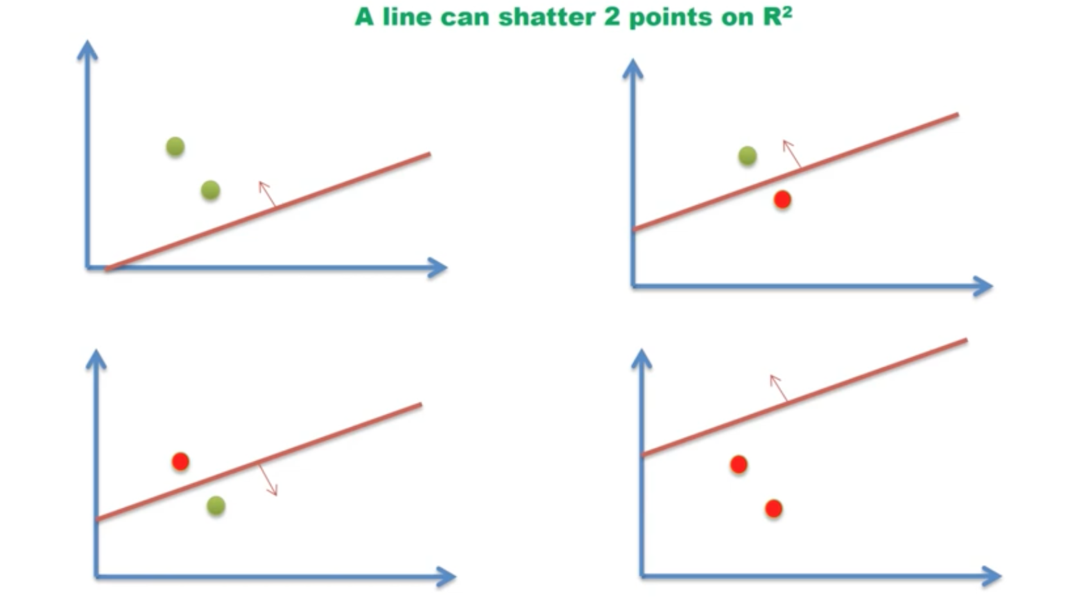

Slide 12
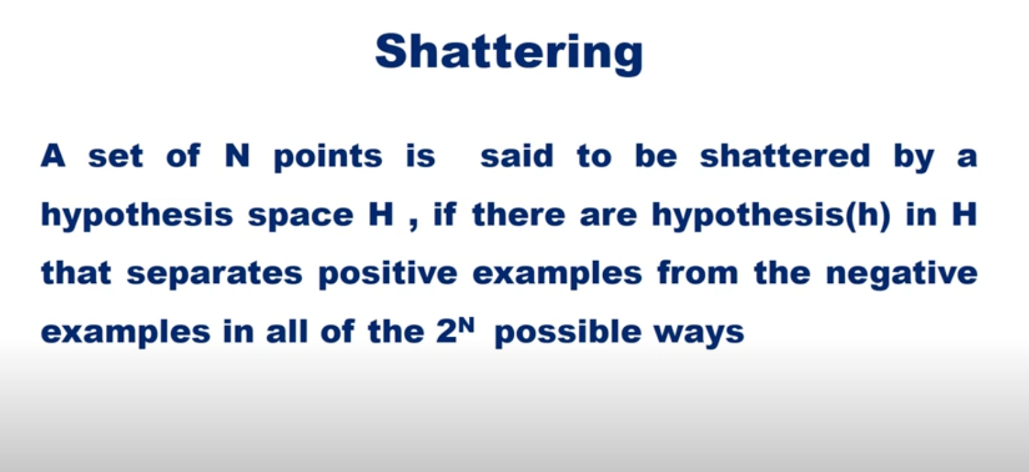

Slide 13
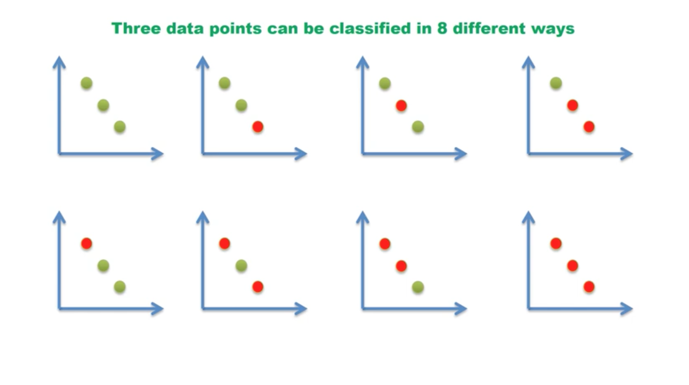

Slide 14
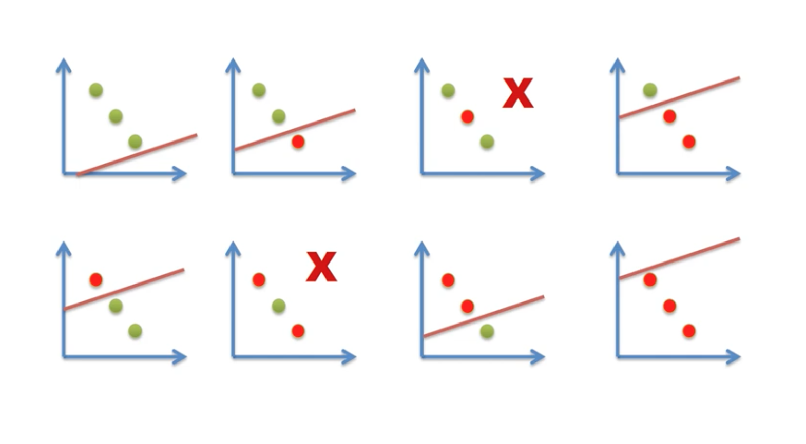

Slide 15
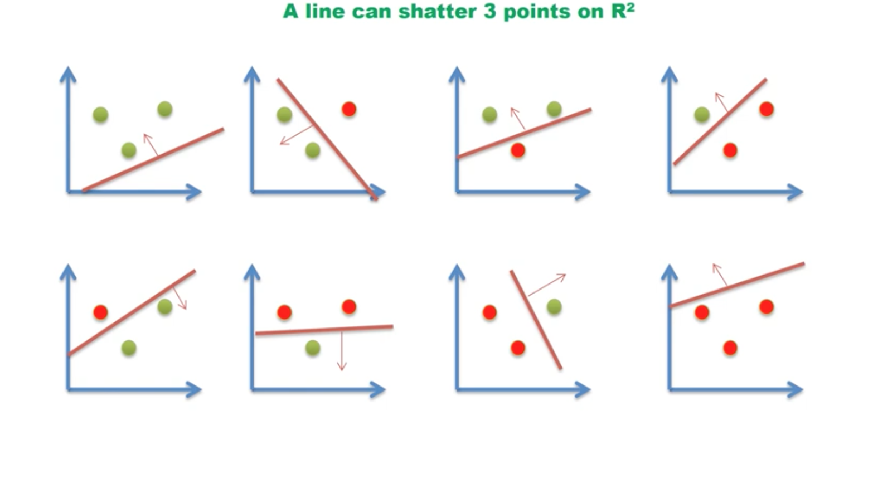

Slide 16
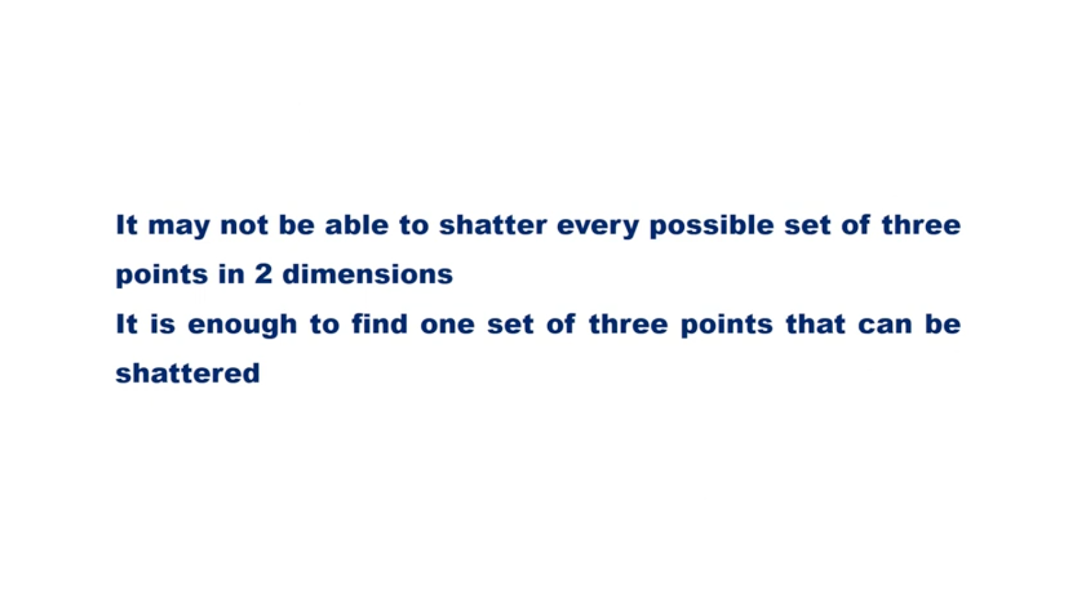

Slide 17
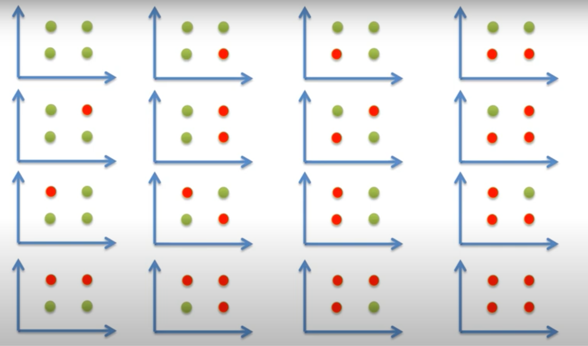

Slide 18
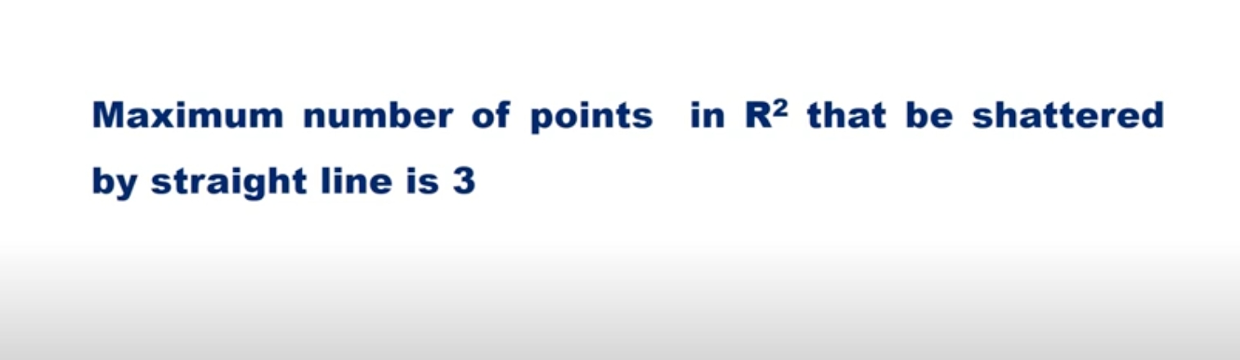
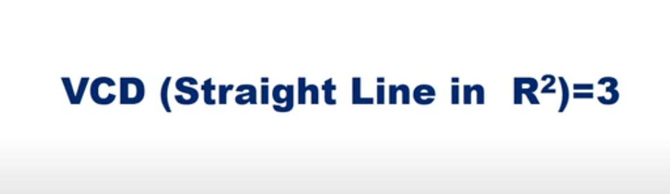

Slide 19
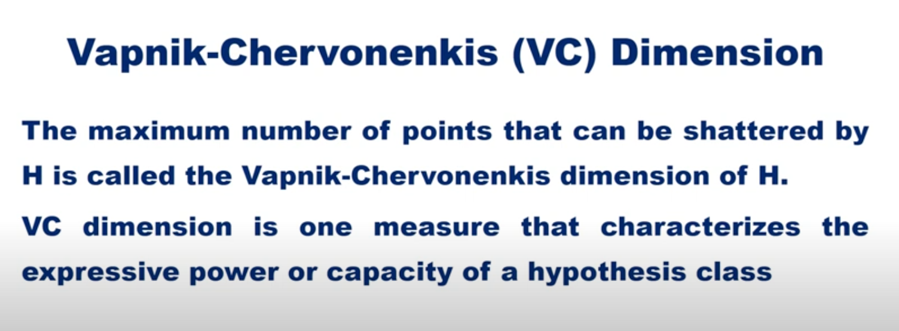

Slide 20
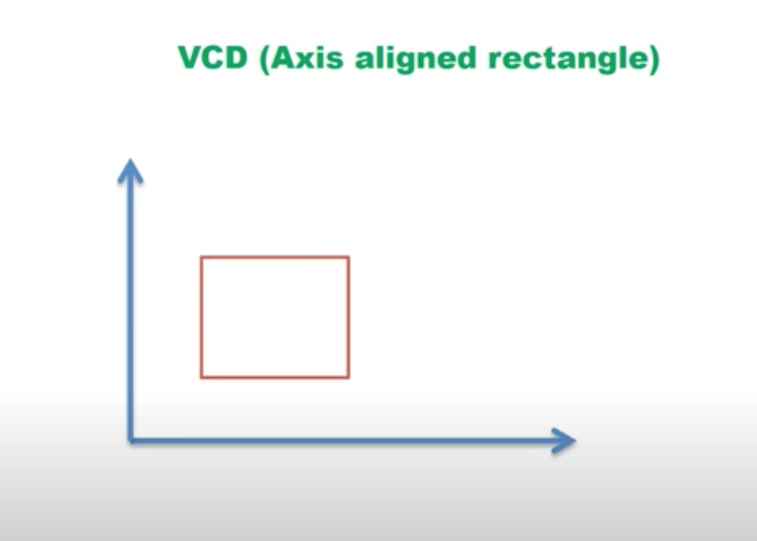

Slide 21
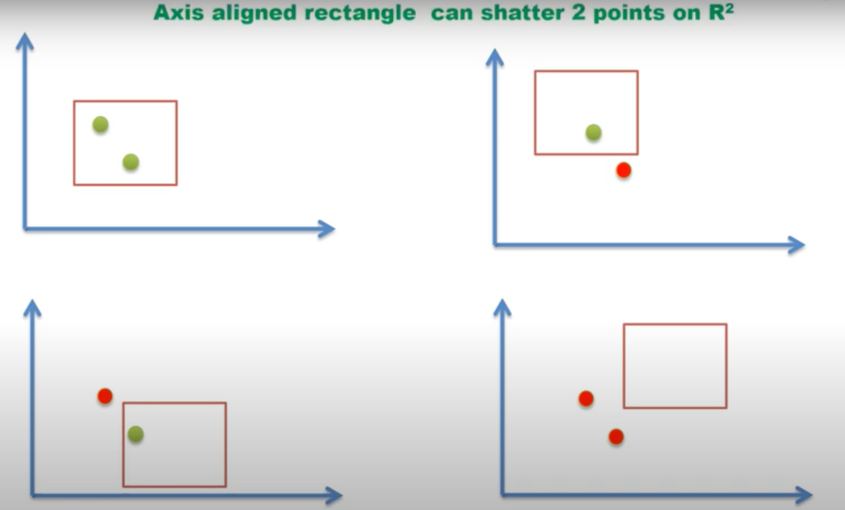

Slide 22
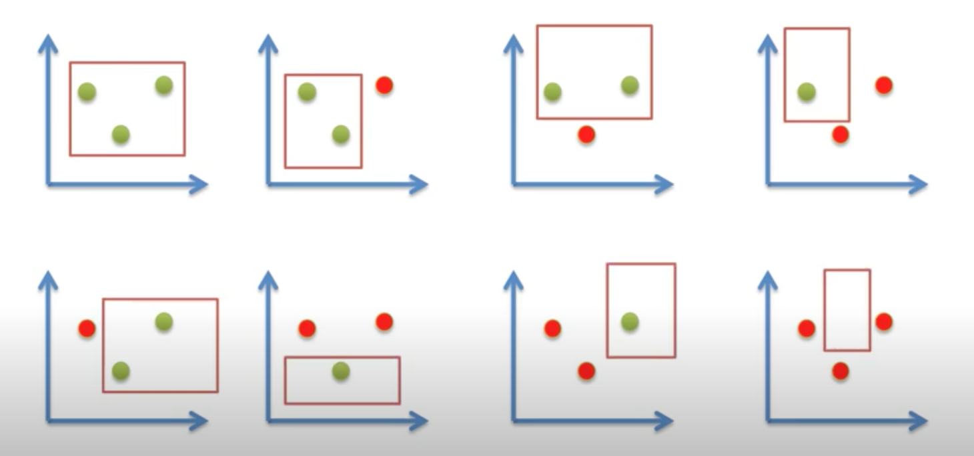

Slide 23
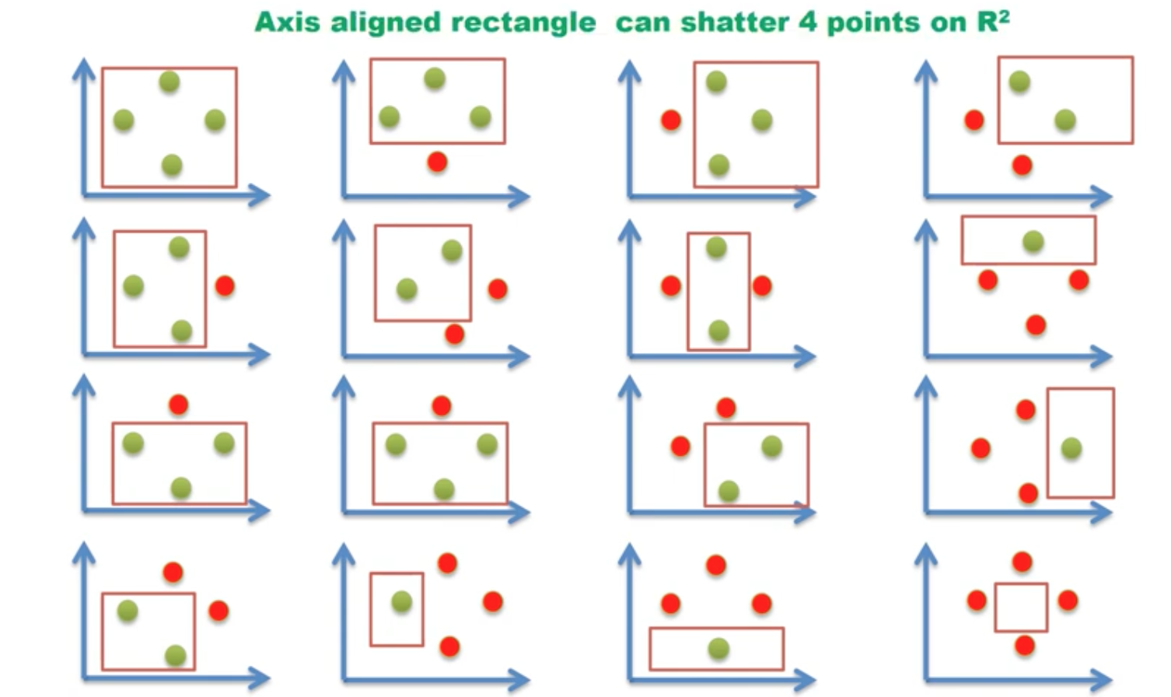

Slide 24
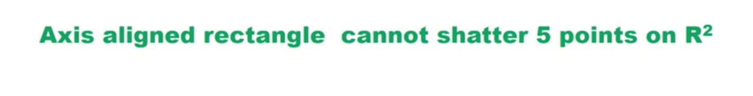
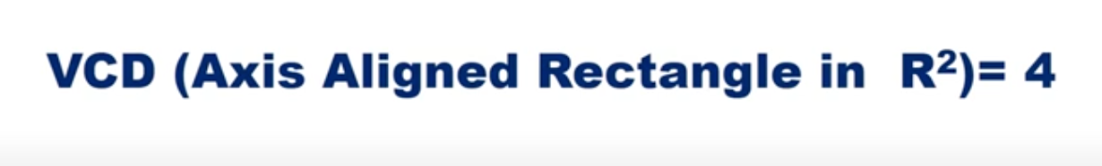

Slide 25
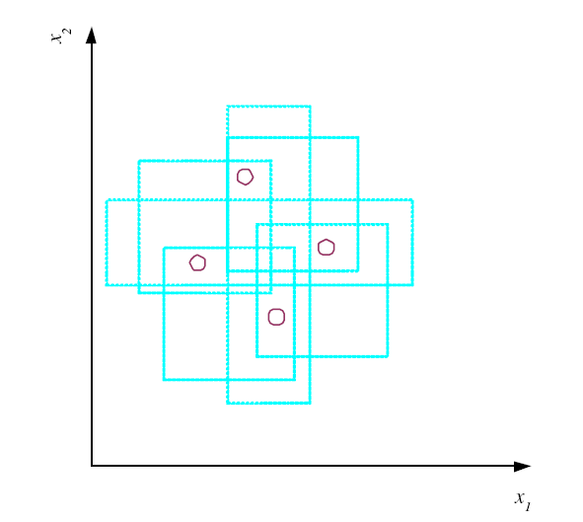
VC Dimension
N points can be labeled in 2^{N} ways as +/–
H shatters N if there
exists h ∈ H consistent
for any of these:
VC(H ) = N
An axis-aligned rectangle shatters 4 points only !

Slide 26
Vapnik-Chervonenkis (VC) Dimension
VC Dimension gives a very pessimistic estimate of the classification capacity of a hypothesis class.
For example, it says that we can correctly classify only three points using a straight line hypothesis, and only 4 points using an axis-aligned rectangle hypothesis.
What’s Missing: VC Dimension does not take into account the probability distribution from which instances are drawn.
In real life, the world usually changes smoothly. Instances that are close to each other usually share the same label.
Thus, the classification capacity of a hypothesis class is usually much more than its VC Dimension.

Slide 27
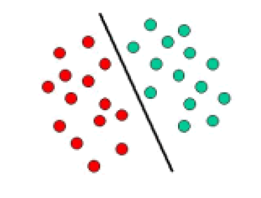
VC Dimension: Real life is more smooth
Classes of neighbor points don’t vary randomly.
Neighbor points usually have the same class.
We know that the classification capacity of a line in 2-D is
usually much more than 3 points!

Slide 28
Probably Approximately Correct (PAC) Learning
PAC learning framework is a branch of computational learning theory.
Probably approximately correct learning (PAC learning) is a framework of learning that was proposed by Leslie Valiant in his paper A theory of the learnable.
In this framework the learner gets samples that are classified according to a function from a certain class. The aim of the learner is to find an approximation of the function with high probability. We demand the learner to be able to learn the concept given any arbitrary approximation ratio, probability of success or distribution of the samples.

Slide 29
Probably Approximately Correct (PAC) Learning
When we learn a hypothesis, we want it to be approximately correct, i.e., the error probability is bounded by a small value.
PAC Learning: Given
a learner L
a class C
a hypothesis h to learn for class C
a set of examples to learn from, drawn from some unknown but fixed probability distribution p(x)
a maximum error ε > 0 allowed in learning
a probability value δ ≤  1/2
The Problem: Find the number of examples N that the learner L must see so that it can learn a hypothesis h with error at most ε > 0 with probability at least 1 − δ.

Slide 30
Probably Approximately Correct (PAC) Learning
In Probably Approximately Correct (PAC) learning, given a class, C, and examples drawn from some unknown but fixed probability distribution, p(x), we want to find the number of examples, N, such that with probability at least 1 − δ, the hypothesis h has error at most , for arbitrary δ ≤ 1/2 and ε > 0
P{CΔh ≤ ε} ≥ 1 − δ
where CΔh is the region of difference between C and h.

Slide 31
Probably Approximately Correct (PAC) Learning
We don’t need a hypothesis with zero error. There might be some error as long as it is small (bounded by a constant ε).
We don’t need to always produce such a good enough hypothesis. The probability of failure should be bounded by a constant δ.
A class of concepts C (defined over an input space with examples of size n) is PAC learnable by a learning algorithm L, if for arbitrary small δ and ε, and for all concepts c in C, and for all distributions D over the input space, there is a 1-δ probability that the hypothesis h selected from space H by learning algorithm L is approximately correct (has error less than ε).

Slide 32
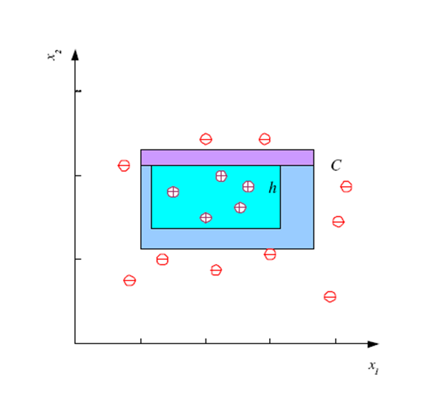
PAC Learning for the Tightest Rectangle Hypothesis
Assume a learning algorithm L uses the tightest rectangle that is most specific (touches the positive examples at the border of the rectangle).
Question: Is this class of problems PAC learnable by L?
Each side (strip) is the error region
true concept c
hypothesis h (most specific)
The error region is (between C and h) is the sum of four rectangular strips

Slide 33
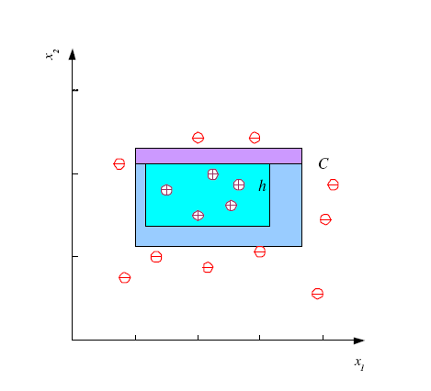
PAC Learning for the Tightest Rectangle Hypothesis
How many training examples N should we have, such that with probability at least 1 ‒ δ, h has error at most ε ? (Blumer et al., 1989)
Each strip is at most ε/4
Pr that we miss a strip 1‒ ε/4
Pr that N instances miss a strip (1 ‒ ε/4)^{N}
Pr that N instances miss 4 strips 4(1 ‒ ε/4)^{N}
4(1 ‒ ε/4)^{N} ≤ δ and (1 ‒ x)≤exp( ‒ x)
4exp(‒ εN/4) ≤ δ and N ≥ (4/ε)log(4/δ)

Slide 34
PAC Learning for the Tightest Rectangle Hypothesis
After computations, we obtain
N ≥ (4/ε)log(4/δ)
Therefore, provided that we take at least (4/ε)log(4/δ) independent examples from C and use the tightest rectangle as our hypothesis h, with confidence probability at least 1 − δ, a given point will be misclassified with error probability at most ε.

Slide 35
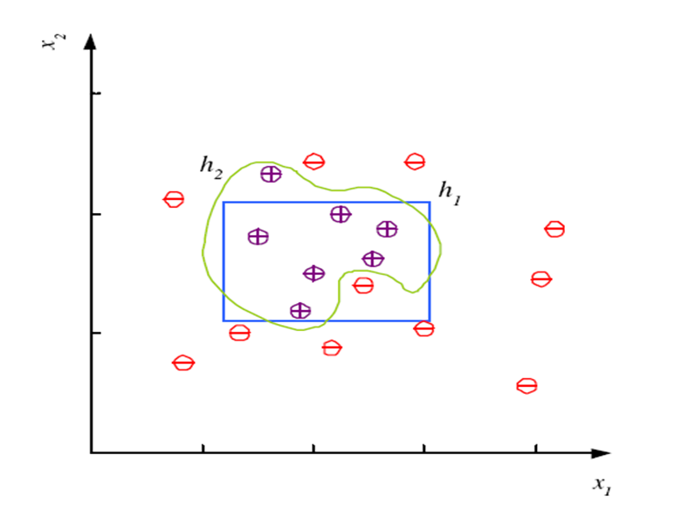
Noise
Noise is any unwanted anomaly in the data.
Noise

Slide 36
Noise
There may be noise in the training examples due to several reasons.
There may be imprecision in recording the input attributes, which may shift the data points in the input space.
There may be errors in labeling the data points, which may label positive instances as negative and vice versa. This is sometimes called teacher noise.
There may be additional attributes, which we have not taken into account, that affect the label of an instance. Such attributes may be hidden or latent in that they may be unobservable. The effect of these neglected attributes is thus modeled as a random component and is included in “noise.” For example, the color attribute may be important in classifying a car as a family car. But, we are not considering this attribute.

Slide 37
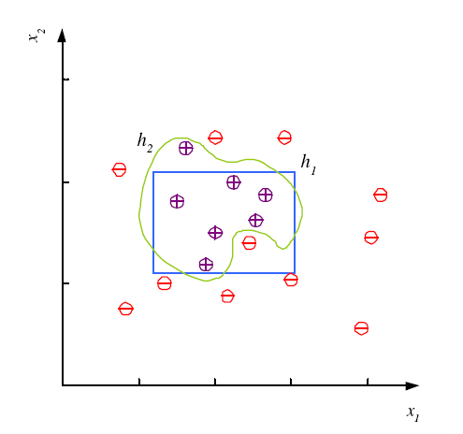
Noise and Model Complexity
Due to noise, the class may be more difficult to learn and zero error may be infeasible with a simple hypothesis class.
When we have noise, there is no simple boundary between positive and negative examples.
With noise, one needs a complicated hypothesis that corresponds to a hypothesis class with larger capacity.
An axis-aligned rectangle needs 4 parameters, but a complex hypothesis needs more parameters to obtain 0 error.

Slide 38
Noise and Model Complexity
Use a simple hypothesis (unless its training error is much bigger)
A simple hypothesis is preferred because of the following:
It is simple to use. For example, we can check whether a point is inside a rectangle more easily than other shapes.
it is simple to train and has fewer parameters. Thus, it needs fewer training examples.
It is a simple model to explain.
if there is error in the input training data, a simple hypothesis may generalize better, being able to classify unseen examples better in the future. (This principle is known Occam’s razor as Occam’s razor, which states that simpler explanations are more reasonable and any unnecessary complexity should be shaved off).

Slide 39
Learning Multiple Classes
In our example of learning a family car, we have positive examples belonging to the class family car and the negative examples belonging to all other cars. This is a two-class problem.
In machine learning, multiclass or multinomial classification is the problem of classifying instances into more than two classes.
In the general case, we have K classes denoted as C_{i}, i = 1, . . . , K, and an input instance belongs to one and exactly one of them.

Slide 40
Noise and Model Complexity
Use the simpler one because
Simpler to use
(lower computational
complexity)
Easier to train (lower
space complexity)
Easier to explain
(more interpretable)
Generalizes better (lower
variance - Occam’s razor)

Slide 41
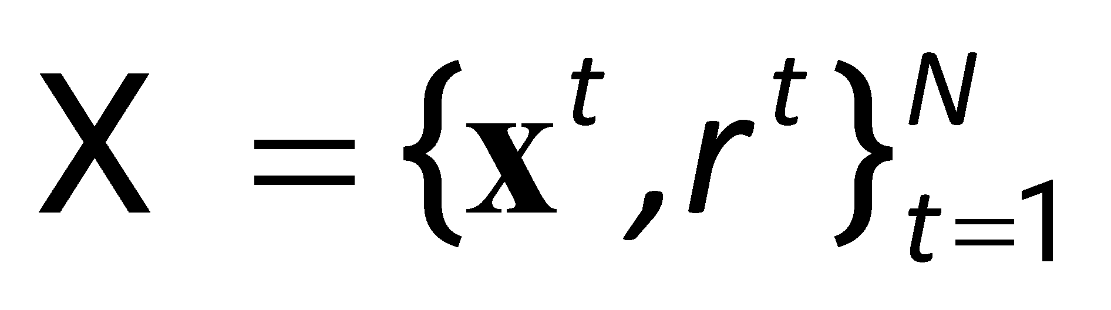
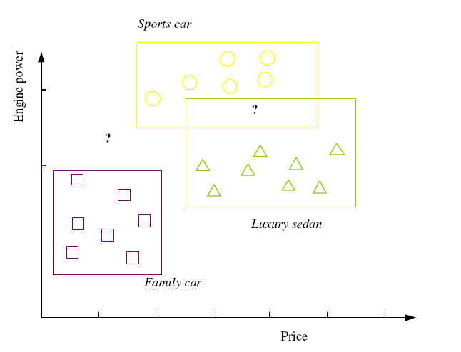
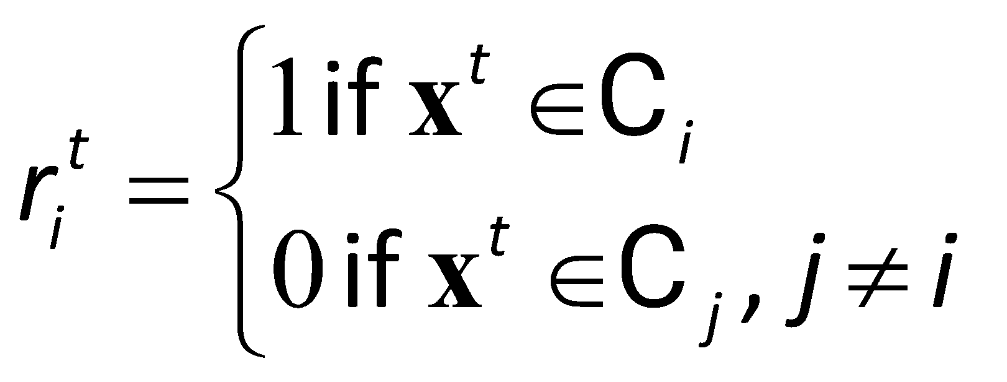
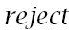
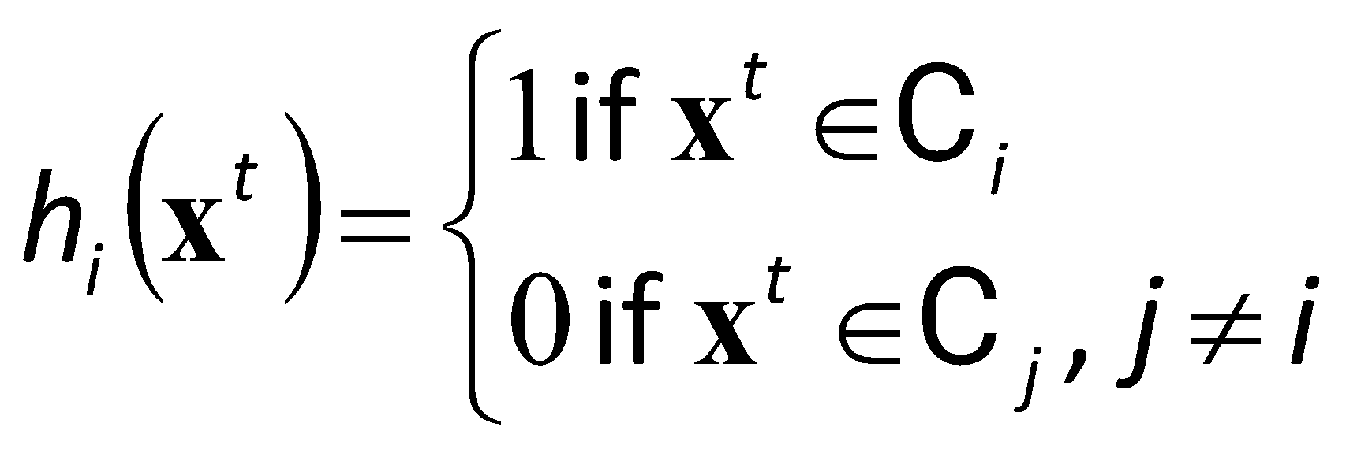
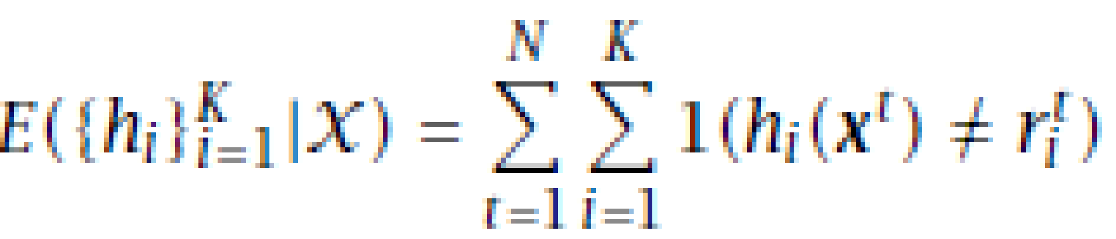
Multiple Classes, C_{i} i=1,...,K
Train hypotheses
h_{i}(x), i =1,...,K:
The total empirical error:

Slide 42
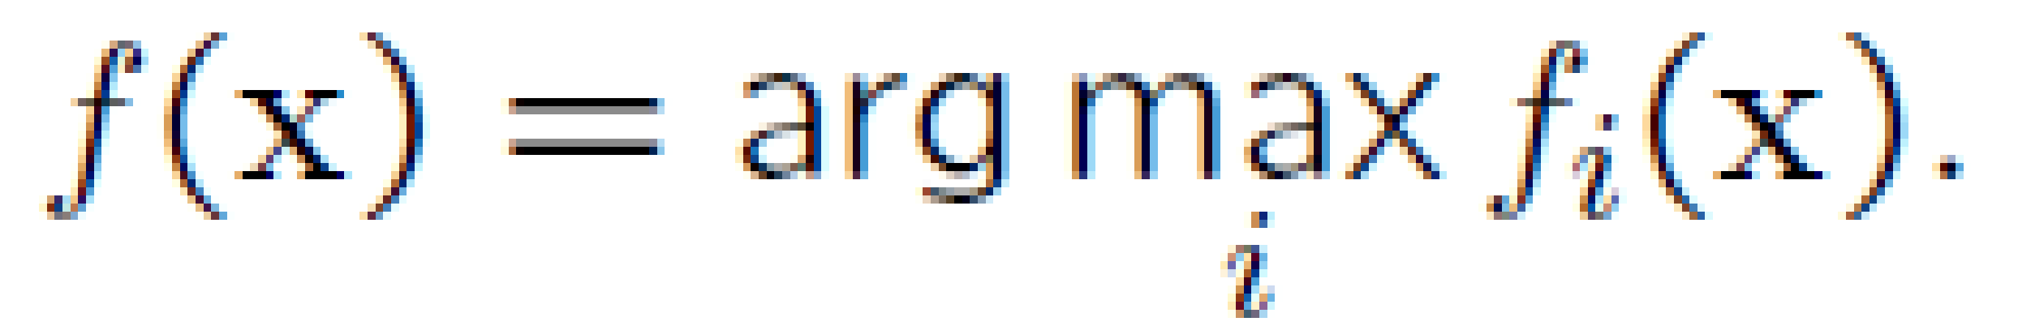
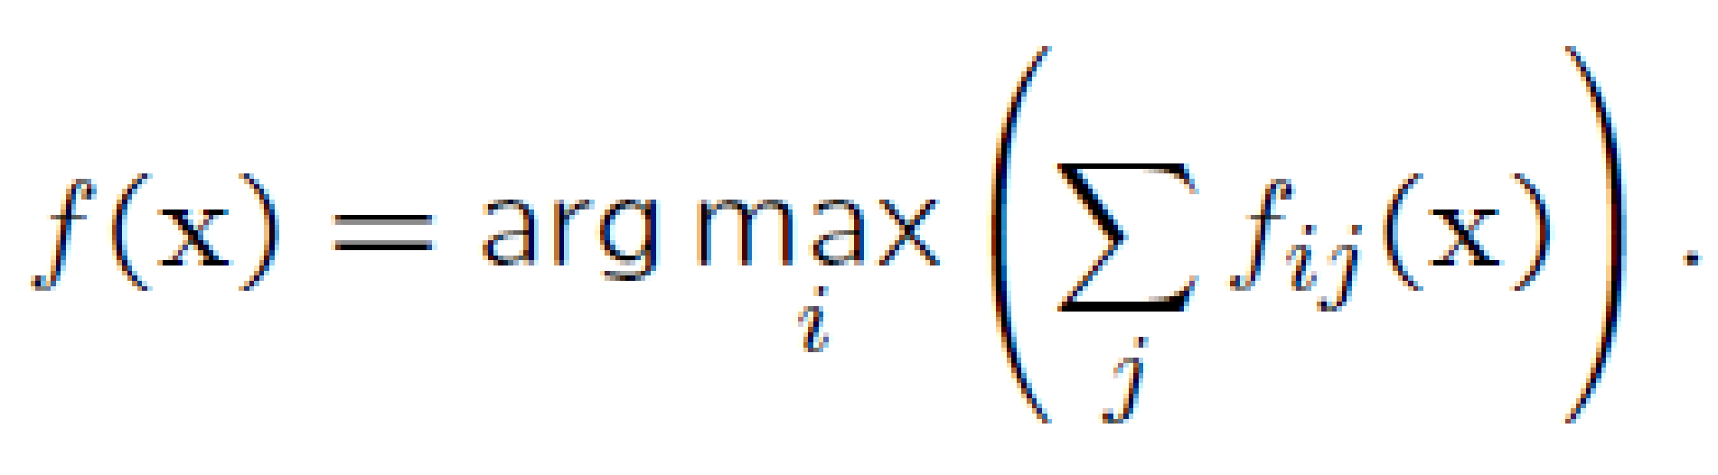
Multiclass classification
While some classification algorithms naturally permit the use of more than two classes, others are by nature binary algorithms; these can, however, be turned into multinomial classifiers by a variety of strategies.
Using binary classifiers, a multi-class classifier can be implemented by using following strategies:
One-against-all (One-vs-All) : Train K classifiers. Each classifier f_{i} is trained per class to distinguish that class from all other classes.
One-against-one (All-vs-All): Construct a binary classifier for each pair of classes. We need 1/2 K(K − 1) classifiers. One classiﬁer f_{ij} is needed to distinguish each pair of classes i and j.

Slide 43
Regression
In statistics, regression analysis is a statistical process for estimating the relationships among variables. It includes many techniques for modeling and analyzing several variables, when the focus is on the relationship between a dependent variable and one or more independent variables.
The estimation target is a function of the independent variables called the regression function.
Regression analysis is widely used for prediction and forecasting, where its use has substantial overlap with the field of machine learning.

Slide 44
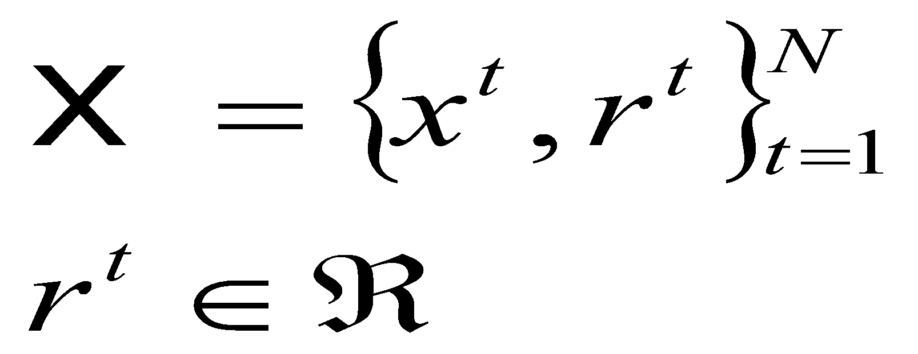
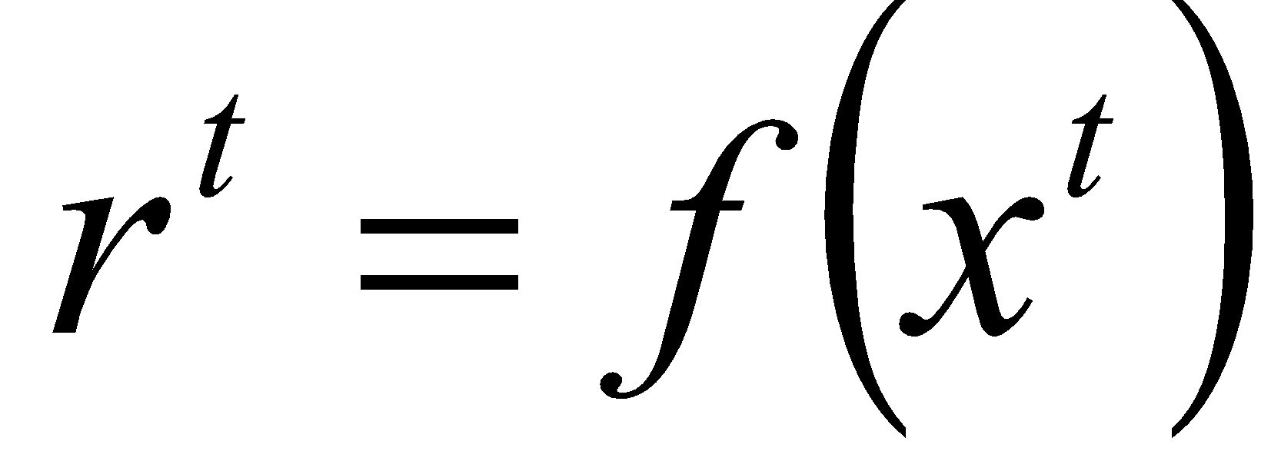
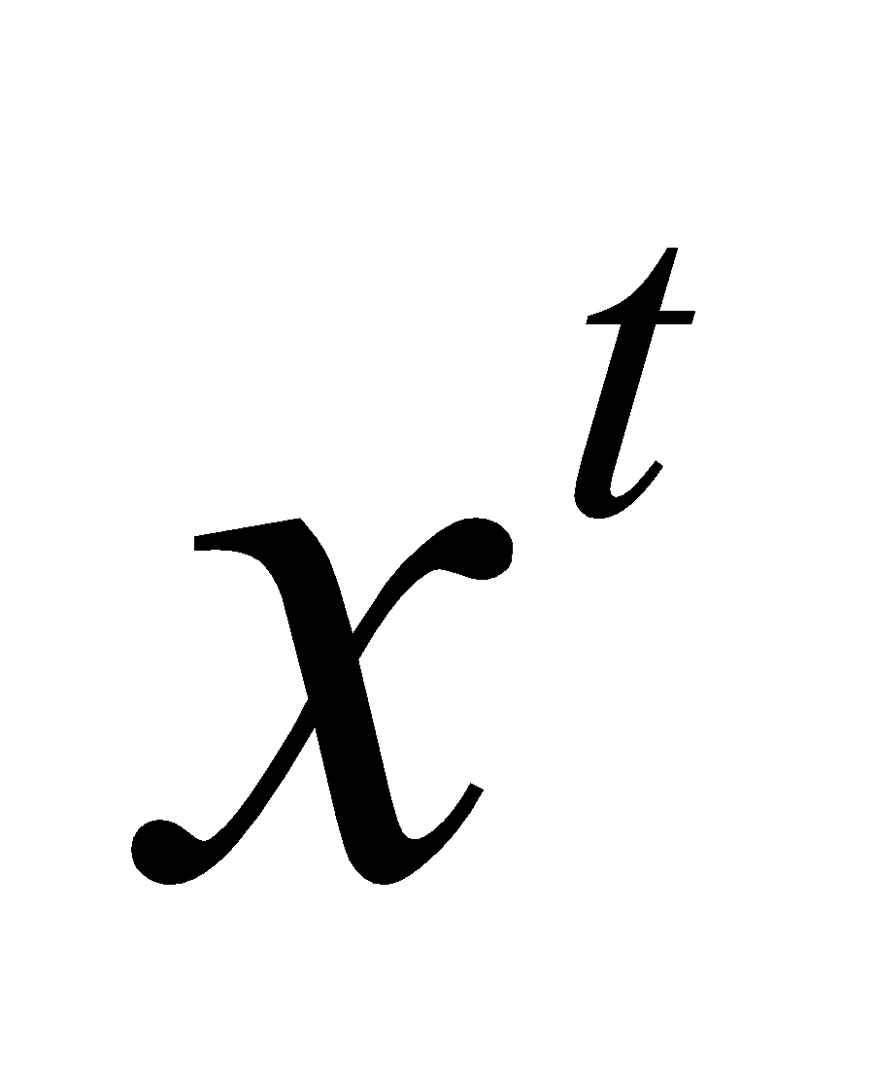
Regression
When the target variable that we’re trying to predict is continuous, we call the learning problem a regression problem.
Given a training set of examples
We would like to find the function f (x) that passes through these points such that we have
If there is no noise, the task is interpolation. In polynomial interpolation, given N points, we find the (N−1)st degree polynomial that we can use to predict the output for any x .
if x is outside of the range of in the training set, then it is called extrapolation.

Slide 45
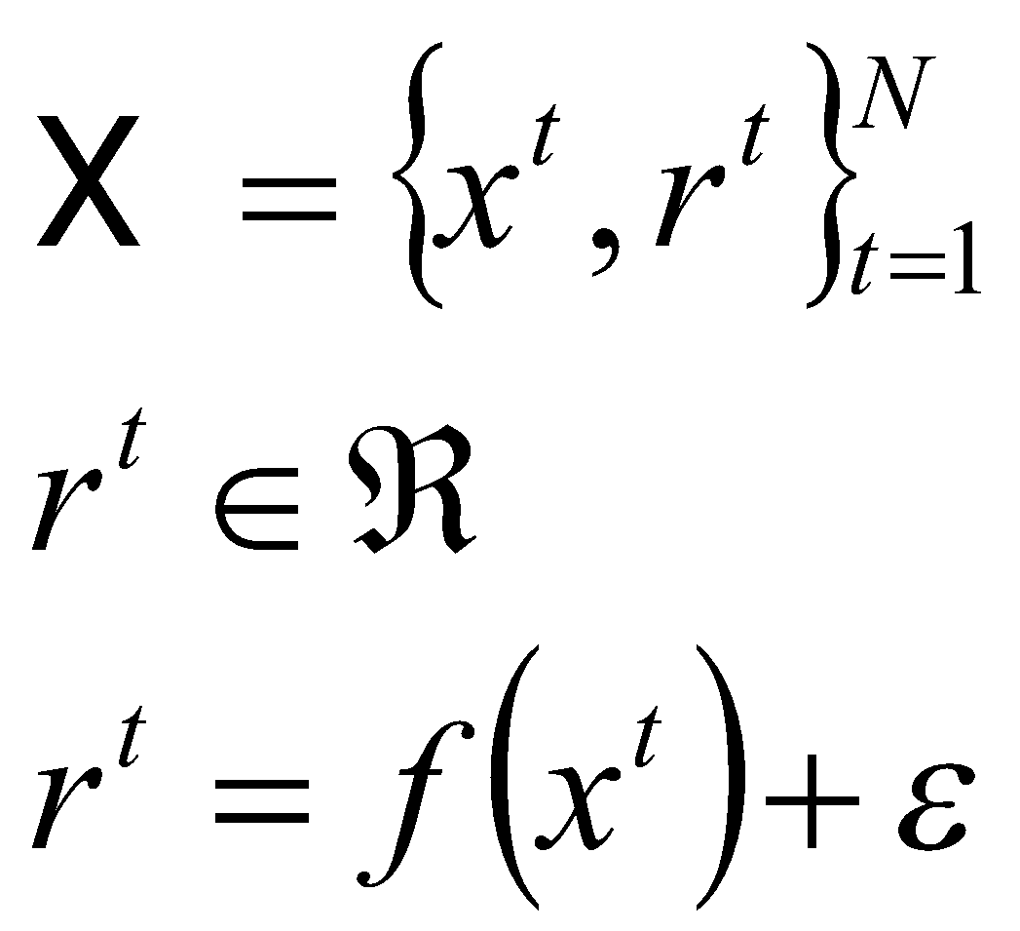
Regression
In regression, there is noise added to the output of the unknown function
where f (x) ∈ is the unknown function and ε is random noise.
The explanation for noise is that there are extra hidden variables that we cannot observe.

Slide 46
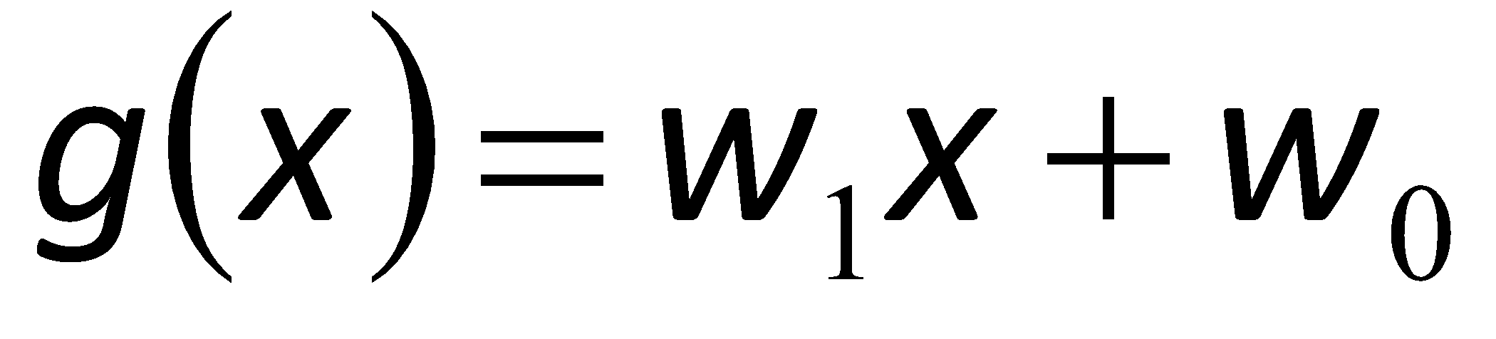
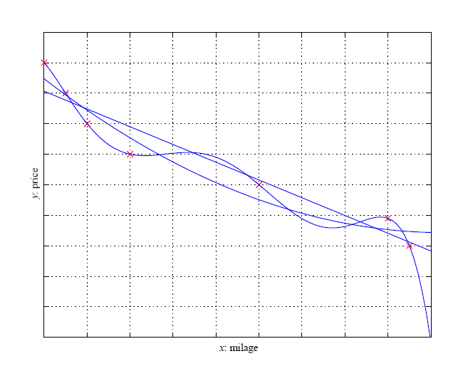
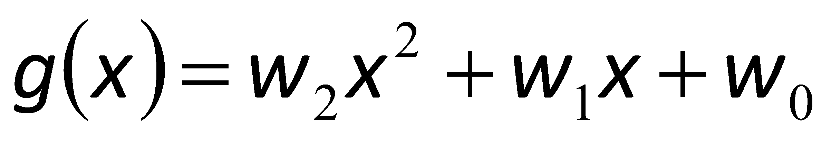
Regression
Example: estimate the price of a used car using price and milage.
Linear, second-order, and sixth-order polynomials are fitted to the same set of points. The highest order gives a perfect fit, but given this much data it is very unlikely that the real curve is so shaped. The second order seems better than the linear fit in capturing the trend in the training data.

Slide 47
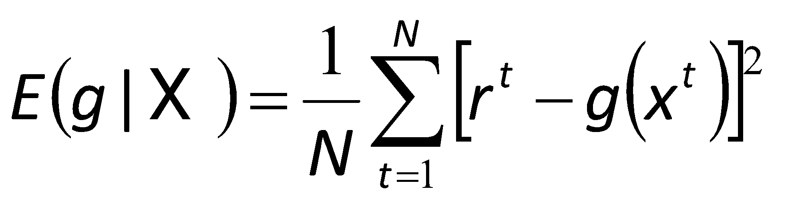
Regression
If we would like to approximate the output by our model g(x). The empirical error on the training set X is
Where the square of the difference is used in error (loss) function. Another is one to use the absolute value of the difference.
Our aim is to find g(·) that minimizes the empirical error.

Slide 48
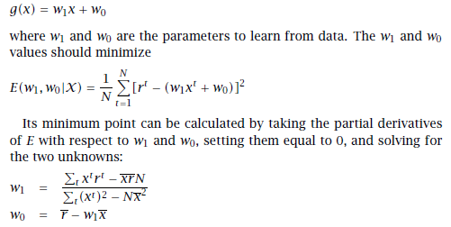
Regression
Example: estimation of the price of a used car by using a single input linear model. w₁ is price and w₂ is milage.
If the linear model is too simple, it is too constrained and incurs a large approximation error, and in such a case, the output may be taken as a higher-order function of the input. For example, quadratic function can be used.

Slide 49
Model Selection & Generalization
Learning is an ill-posed problem; data is not sufficient to find a unique solution
The mathematical term well-posed problem stems from a definition given by Hadamard.
He believed that mathematical models of physical phenomena should have the properties that
A solution exists.
The solution is unique.
The solution's behavior hardly changes when there's a slight change in the initial condition (topology).
Problems that are not well-posed in the sense of Hadamard are termed ill-posed.
http://en.wikipedia.org/wiki/Well-posedness

Slide 50
Fundamental Problem of Machine Learning: It is ill-posed
Imagine we are trying to learn a Boolean function (all inputs and outputs are binary) from examples. There are 2^{d} possible ways to write d binary values and therefore, with d inputs, the training set has at most 2^{d} examples.
Each of these examples can be labeled as 0 or 1, and therefore, there are ₂2^{d} possible boolean functions of d inputs.
Each distinct training example removes half the hypotheses, namely those whose guesses are wrong for that example.

Slide 51
Fundamental Problem of Machine Learning: It is ill-posed
This is one way to interpret inductive learning: we start with all possible hypotheses and as we see more training examples, we remove those hypotheses that are not consistent with the training data.
In the case of a Boolean function, to end up with a single hypothesis we need to see all 2^{d} training examples.
If the training set we are given contains only a small subset of all possible instances, as it generally does, the solution is not unique.

Slide 52
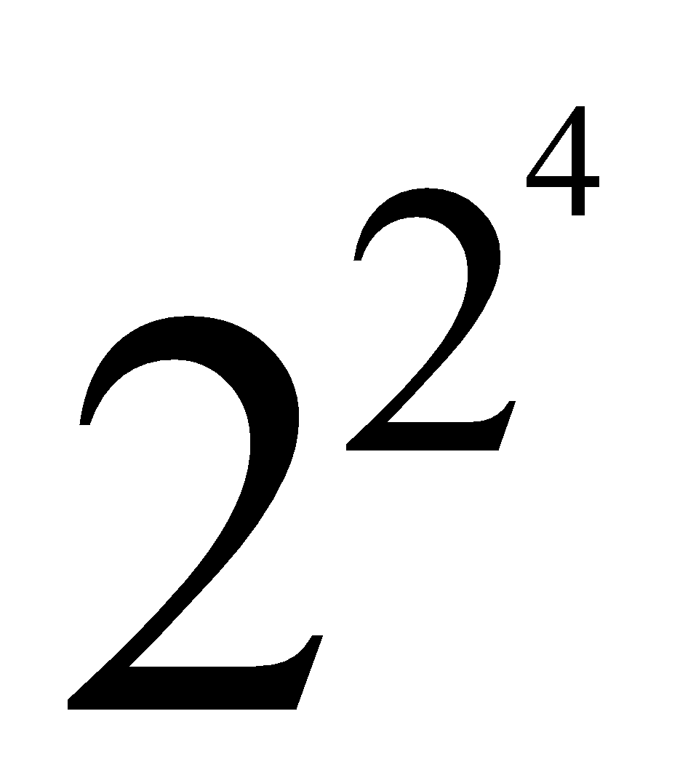
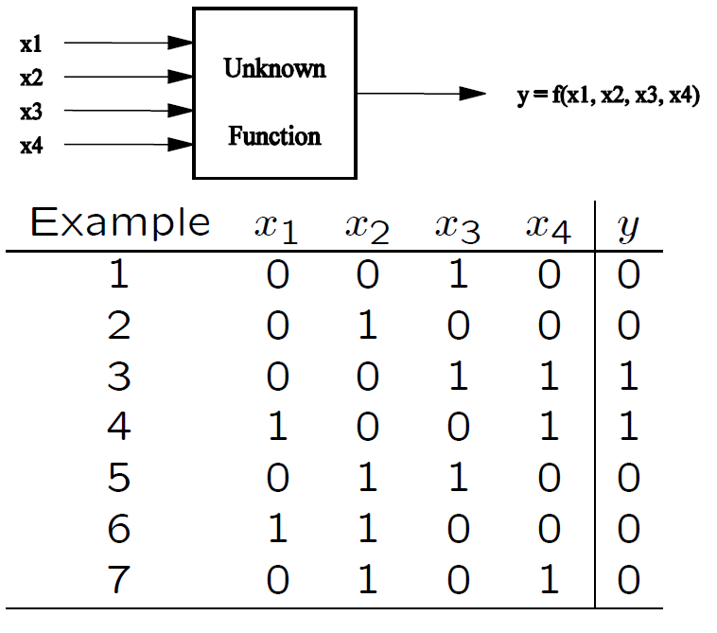
Fundamental Problem of Machine Learning: It is ill-posed
Example: For 4 input variables, there are =65536 hypotheses (boolean functions.)

Slide 53
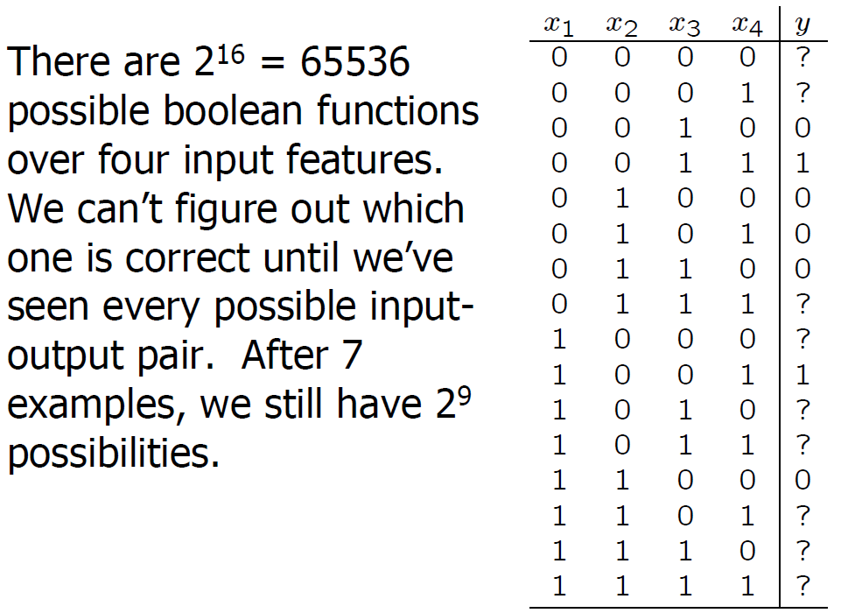
Fundamental Problem of Machine Learning: It is ill-posed

Slide 54
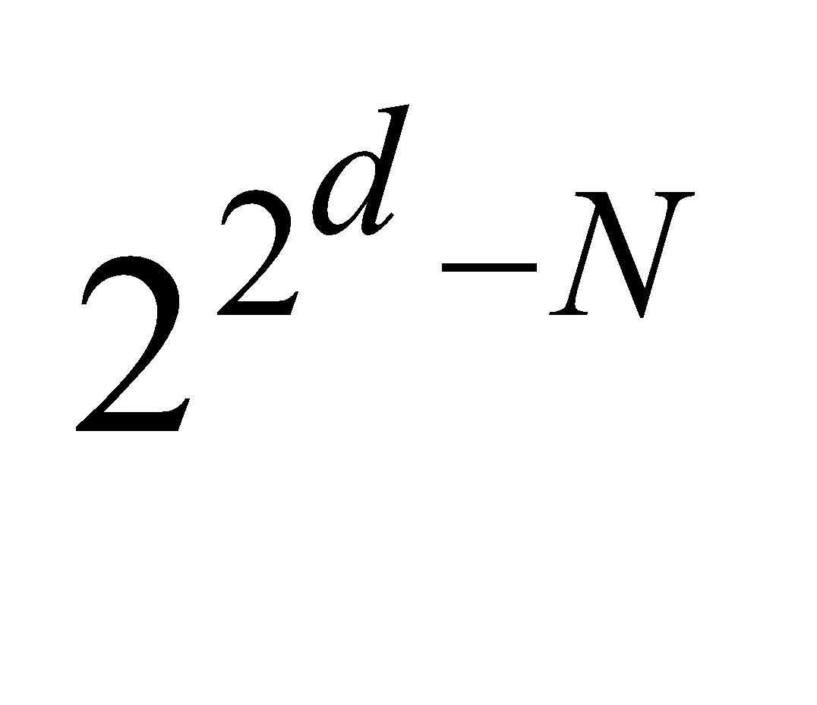

Fundamental Problem of Machine Learning: It is ill-posed
After seeing N examples, there remain possible functions.
This is an example of an ill-posed problem where the data by itself is not sufficient to find a unique solution.
Unless we see all possible examples the data by itself is not sufficient for an inductive learning algorithm to find a unique solution.

Slide 55
Inductive bias
Because inductive learning is ill-posed, we have to make some extra assumptions to have a unique solution with the data we have.
The set of assumptions we make to have learning possible is called the inductive bias of the learning algorithm.
The inductive bias of a learning algorithm:
is a set of assumption about what the true function we are trying to model looks like.
defines the set of hypotheses that a learning algorithm considers when it is learning.
guides the learning algorithm to prefer one hypothesis (i.e. the hypothesis that best fits with the assumptions) over the others.
is a necessary prerequisite for learning to happen because inductive learning is an ill posed problem.

Slide 56
Two Views of Learning
View 1: Learning is the removal of our remaining uncertainty
Suppose we knew that the unknown function was an a boolean function. Then we could use the training examples to deduce which function it is.
View 2: Learning requires guessing a good, small hypothesis class
We can start with a very small class and enlarge it until it contains an hypothesis that fits the data
Source: Sofus A. Macskassy

Slide 57
We could be wrong!
Our prior “knowledge” might be wrong
Our guess of the hypothesis class could be wrong
The smaller the class, the more likely we are wrong

Slide 58
Two Strategies for Machine Learning
Develop Languages for Expressing Prior Knowledge
Rule grammars, stochastic models, Bayesian networks
(Corresponds to the Prior Knowledge view)
Develop Flexible Hypothesis Spaces
Nested collections of hypotheses: decision trees, neural networks, cases, SVMs
(Corresponds to the Guessing view)
In either case we must develop algorithms for finding an hypothesis that fits the data

Slide 59
Model Selection
Thus learning is not possible without inductive bias, and now the question is how to choose the right bias. This is called model selection, which is choosing between possible H .
Model Selection involves selecting between different possible hypothesis spaces H.
In answering this question, we should remember that the aim of machine learning is rarely to replicate the training data but the prediction for new cases.
That is we would like to be able to generate the right output for an input instance outside the training set, one for which the correct output is not given in the training set.
How well a model trained on the training set predicts the right output for new instances is called generalization.

Slide 60
Generalization, Underfitting, Overfitting
For best generalization, we should match the complexity of the hypothesis class H with the complexity of the function underlying the data.
Underfitting: H less complex than C or f
If H is less complex than the function (or class C), we have underfitting.
For example, when trying to fit a line to data sampled from a third-order polynomial.
Overfitting: H more complex than C or f
If H is more complex than the function (or class C), we have overfitting.
For example, If we fit a sixth-order polynomial to a noisy data sampled from a third-order polynomial.

Slide 61
Triple Trade-Off (Dietterich 2003).
In all learning algorithms that are trained from example data, there is a trade-off between three factors:
the complexity of the hypothesis we fit to data, namely, the capacity of the hypothesis class c (H), ,
the amount of training data N, and
the generalization error E on new examples.
As the amount of training data increases, the generalization error decreases. (As N↑, E↓)
As the complexity of the hypothesis space H increases, the generalization error decreases first (as we reduce our underfit) and then starts to increase (as we begin to overfit). (c (H)↑, first E↓ and then E↑)

Slide 62
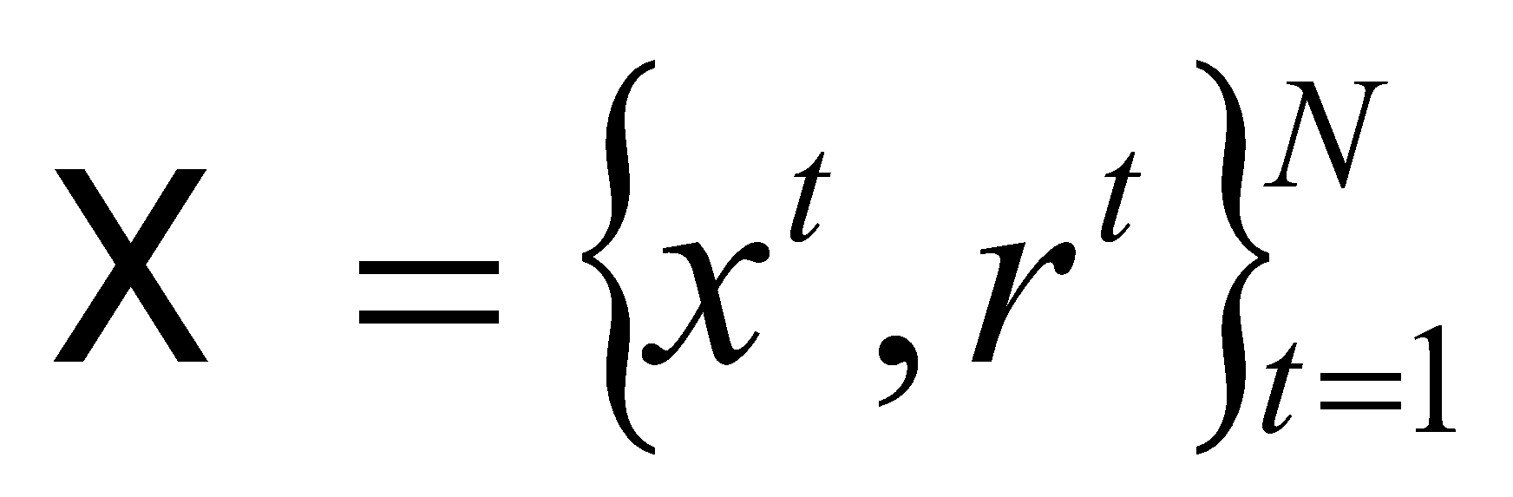
Dimensions of a Supervised Machine Learning Algorithm
Let us now summarize and generalize formally. We have a sample (dataset). The sample is independent and identically distributed (iid); the ordering is not important and all instances are drawn from the same joint distribution p(x, r). t indexes one of the N instances, x^{t} is the arbitrary dimensional input, and r^{t} is the associated desired output.
The aim is to build a good and useful approximation to r^{t} using the model g(x^{t} |θ). In doing this, there are three decisions we must make:
1. Model we use in learning, denoted as
g(x|θ)
where g(·) is the model, x is the input, and θ are the parameters. g(·) defines the hypothesis class H, and a particular value of θ instantiates one hypothesis h ∈ H.

Slide 63
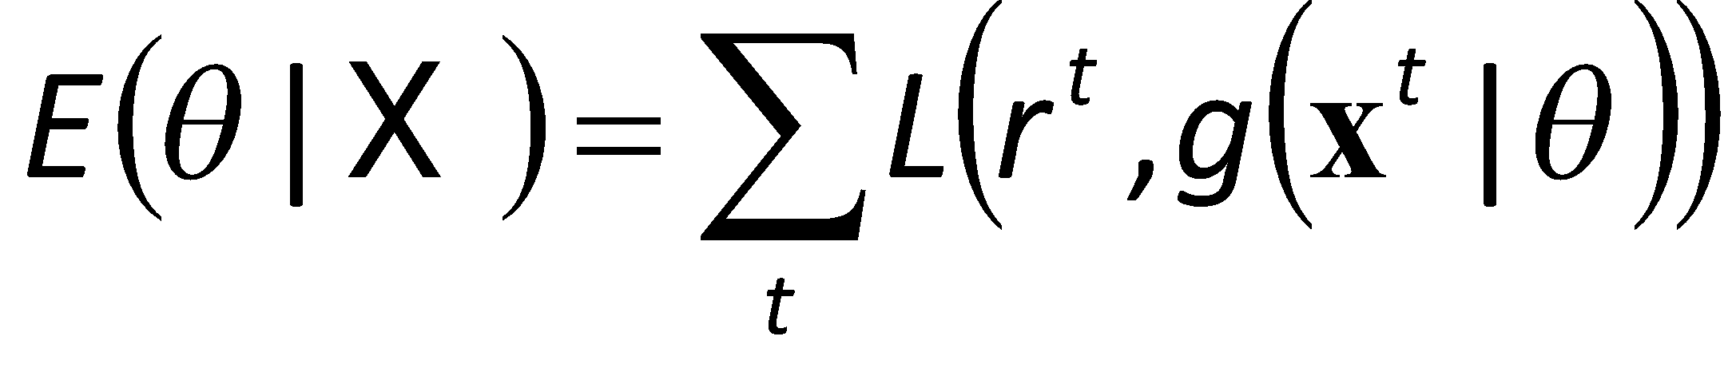
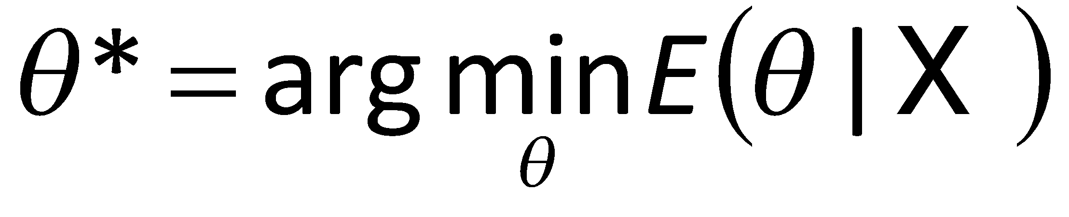
Dimensions of a Supervised Machine Learning Algorithm
2. Loss function, L(·) computes the difference between the desired output, r^{t} , and our approximation to it, g(xt |θ), given the current value of the parameters, θ.
The approximation error, or loss, is the sum of losses over the individual instances
3. Optimization procedure to find θ∗ that minimizes the total error
where argmin returns the argument that minimizes.
In regression, we can solve analytically for the optimum. With more complex models and error functions, we may need to use more complex optimization methods, for example, gradient-based methods, simulated annealing, or genetic algorithms.

Slide 64
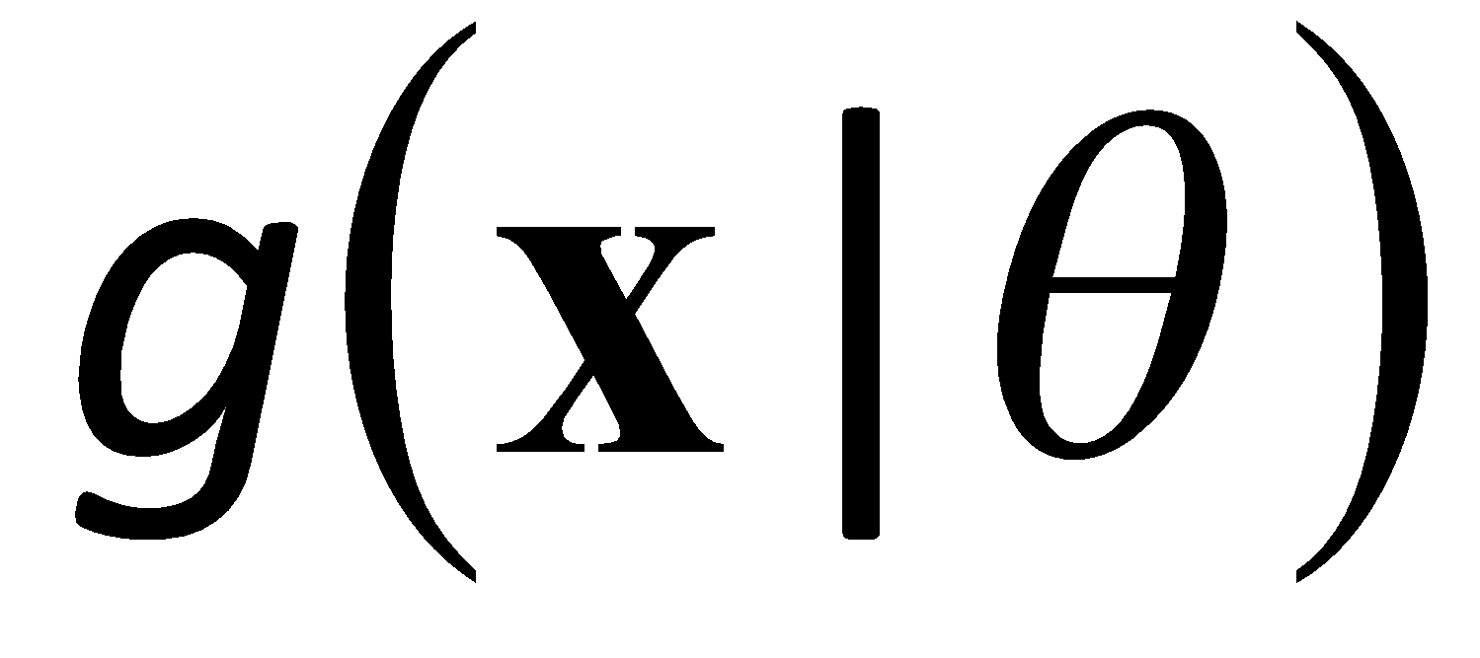

Dimensions of a Supervised Learner
Model:
Loss function:
Optimization procedure:

